Slide 1
Battle of the Neighborhoods: Where to rent after college in Seattle?
Gabriel Trejos
Applied Data Science Capstone

Slide 2
Problem Synopsis
A recent college graduate will have on average $1200 available for rent.
Choosing the right neighborhood goes beyond the right rent price.
Significant time and energy spent in web browsing searching for the right neighborhood and apartment.
Are higher rent prices associated with a higher diversity and access to venues.

Slide 3
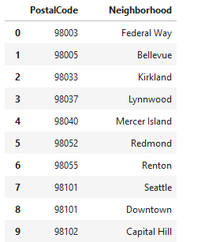
Data Seattle Postal Codes:seattlearea.com

Slide 4
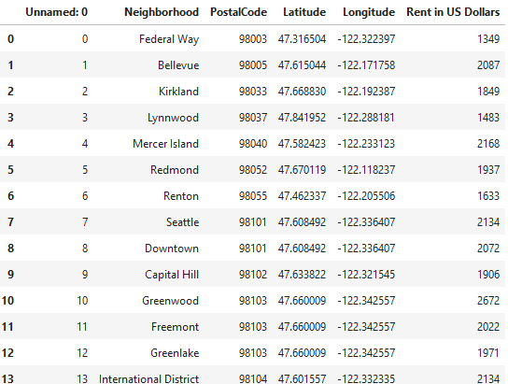
Data Average Rent from rentcafe.com

Slide 5
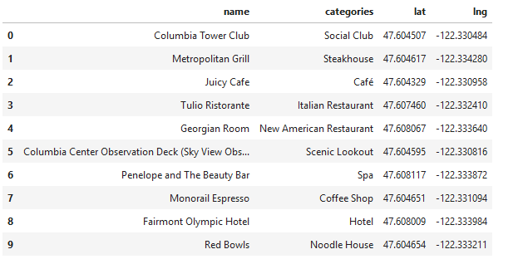
Data Venue Info: FourSquare.com

Slide 6
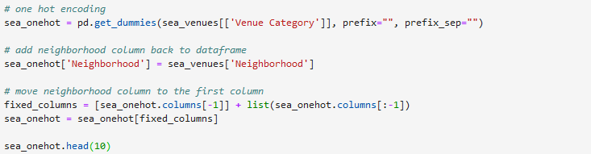
Data Preprocessing One Hot Encoder
We use the one hot encoder to pre process the data by binarizing the categories in each of the grouped venues.

Slide 7
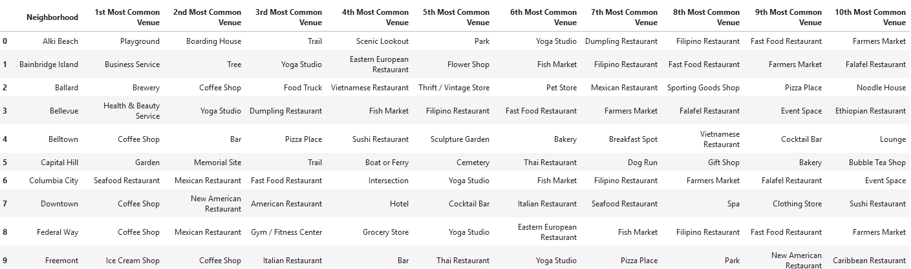
Data Preprocessing Choosing the Top Venues
Data is organized by the most common venues of each of the neighborhoods, restricting the values to the 10 most common.

Slide 8
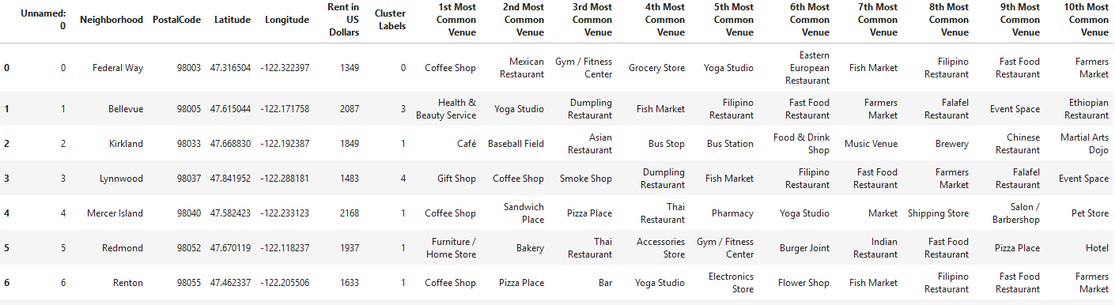
Data Preprocessing Merging all the data
Venues data is merged with geographical data.

Slide 9
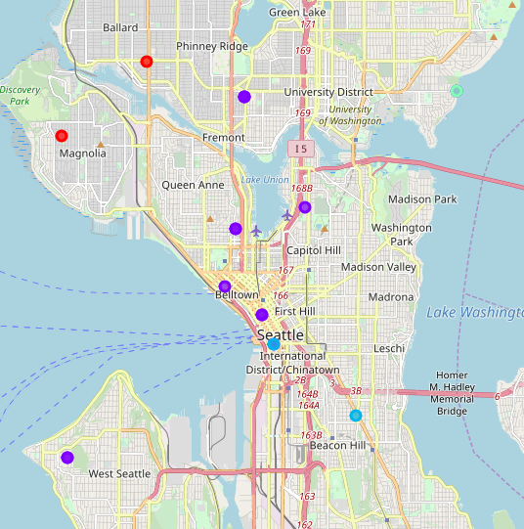
Clusters Map Map with 5 clusters

Slide 10
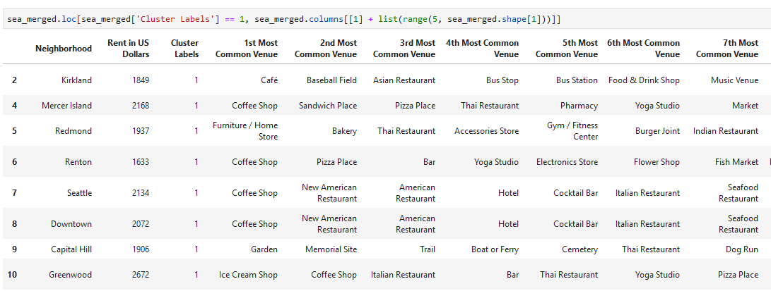
Tables Tables of each cluster with 10 most common venues

Slide 11
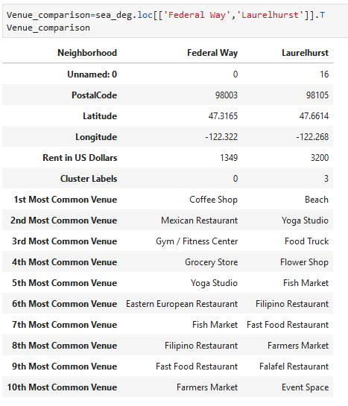
Venues comparison Laurelhurst vs Federal Way Neighborhood

Slide 12
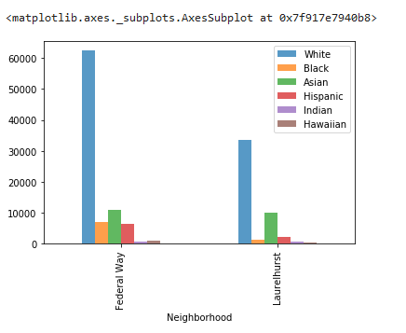
Demographic Info by Neighborhood

Slide 13
Discussion
Laurelhurst (cluster 3) rent’s price of $3200 could be attributed mainly to its proximity to the beach as well as a social status of the area and people inhabiting the neighborhood. Similar neighborhoods in the same cluster indicate that most common venues fall under a luxurious category.
Federal Way (cluster 0) rent’s price of $1349 reflects a more diverse neighborhood with the presence of minority groups including Hispanic, black and Asian. However there is also a high number of white population, which could be a sign of a healthy neighborhood.

Slide 14
Conclusion
Based on the comparison of the two neighborhoods Laurelhurst and Federal Way, I recommend a recent graduate or low-income worker to rent in Federal Way. People in Laurelhurst and other neighborhoods in a similar cluster rent an apartment in the area due to its proximity to the beach and venues that could be considered luxurious. For surviving, the venues located in Federal Way and other neighborhoods within that cluster serve different basic necessities ranging from meals, to groceries to access to public transportation.

Slide 15
Thank You!!

